Slide 1
A guide to Revision Control with TortoiseHg (individual use)
Prepared by: Steve Teo

Slide 2
Introduction to TortoiseHg
TortoiseHg is an easy to use graphical client which integrates into the Windows Shell for the Mercurial Revision Control System (RCS) on the Windows operating system.
TortoiseHg comes with Mercurial by default
Download the latest version of TortoiseHg from http://tortoisehg.bitbucket.org/

Slide 3
Objectives
Learn basic concepts of Revision Control System (RCS) for individual use
Know how to
Create a local repository
Add files to the repository
Check in changes to the repository
View differences between revisions
Revert changes to files
Label a revision for easy reference

Slide 4
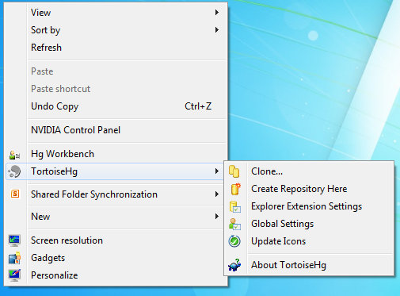
After installation
The explorer context menu will have two new commands. TortoiseHg allows for quick access to commonly used operations. Hg Workbench is a full-fledged application for interacting with repositories.
We will focus on TortoiseHg for the purpose of this tutorial.
Quick access to operations

Slide 5
Before we begin…
I am a note
I am an instruction

Slide 6
Create a local repository

Slide 7
What is a repository?
The database where the files and historical data are stored, including the author of the changes and the summary of each change. Commonly called repo for short.
Repository (Repo)

Slide 8

What is a working copy?
The local directory of your files which you work on.

Slide 9


A basic overview
The set of files you are currently working on.
Where files and historical data are stored
works on
Repository (Repo)
file operations
Working Copy
uses
Version Control System Client
interacts
Steve

Slide 10
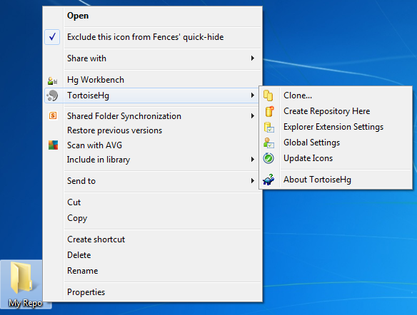
Create a local repository
In Mercurial, repositories can be created locally on a computer.
When we create a repository, we specify a folder where the repository will be created in.
2. Select “Create Repository Here” on the empty folder
1. Create an empty folder

Slide 11
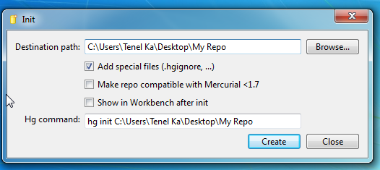
Create a local repository
The equivalent command using the command line
Accept the default options and click “Create”

Slide 12
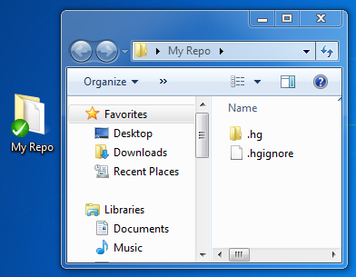
Create a local repository
The repository exists as a special hidden folder, .hg in the selected folder.
The folder which was specified becomes the working copy itself.
The local folder becomes the working copy
The “.hg” directory is the repository.

Slide 13
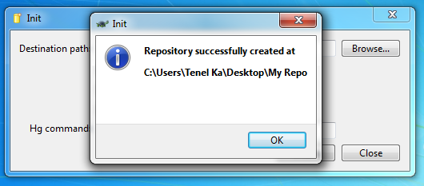
Create a local repository

Slide 14
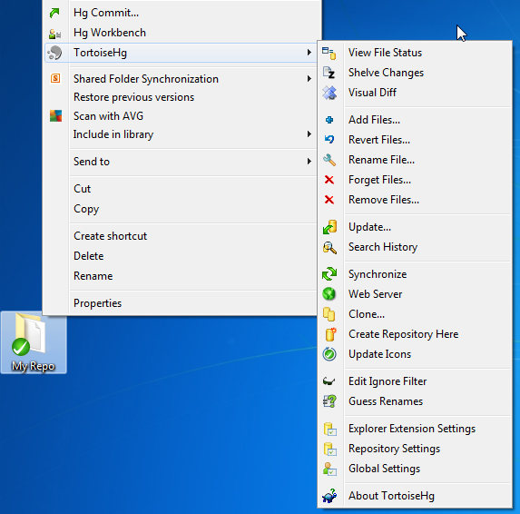
Create a local repository
Additional commands will also be available once a folder has had a repository created within it
Commit command
More commands are available

Slide 15
Add files to the repository

Slide 16
What is “Add”
Tells the Version Control System to track a file, a set of files or a directory. These tracked files do not go into the repository until the next check in.

Slide 17
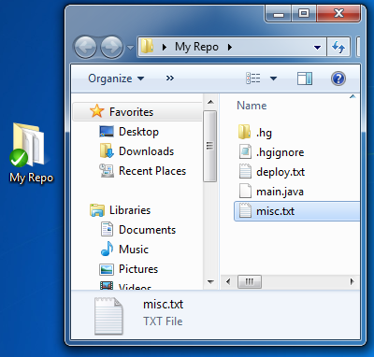
Add files to the repository
Begin by creating new files in the directory. Whenever new files are created, they will not be committed because they haven’t been tracked by the RCS. We need to ‘add’ these files so that they are tracked for commits.
Create these files

Slide 18
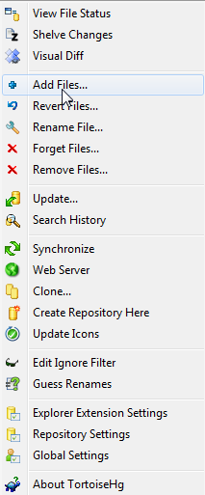
Add files to the repository
Right-click on the folder and select the “Add Files…” command

Slide 19
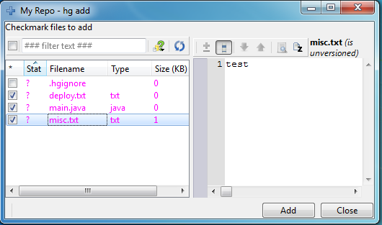
Add files to the repository
“?” status means unknown status, which means it has not been added into the repository
Preview of the contents of the selected file
1. Check the 3 files just created
2. Click “Add” to begin tracking the files for commit

Slide 20
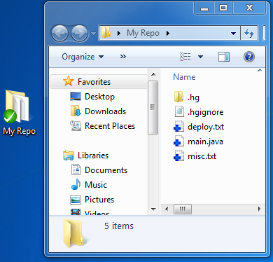
Add files to the repository
Icon indication that the files have been added and are being tracked

Slide 21
Check in changes to the repository

Slide 22

What is a check in?
Uploads a changed file or a set of changed files to the repository. Commonly known as commit.
commit
Repository (Repo)
Working Copy
User
uses
TortoiseHg

Slide 23
What happens during a check in?
Whenever a commit operation happens, files that have been changed with respect to the last commit will be detected.
The user can then select which of these changed files are to be present in the commit. The selected files will have their changes stored.
During a single commit operation, the selected changes are grouped together into what is known as a “revision” and stored into the repository.

Slide 24
What is a revision?
A revision is the set of changes whenever a check in is performed. Each revision is given a number. Every file change has a diff which shows the change to the particular file.
Contains other important information such as the author of the changes and the summary of each change.
Each successful commit will result in a new revision.
Each revision will definitely have one or more revision for its parent except for the first revision, which will have zero.

Slide 25
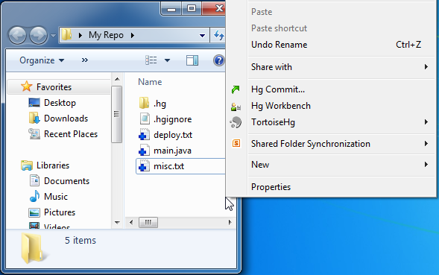
Check in changes to the repository
Although the files have been added and are being tracked, they have not yet been committed.
We need to commit so that changes to the files are saved by the repository.
Right click on the directory and select the “Hg Commit…” command

Slide 26
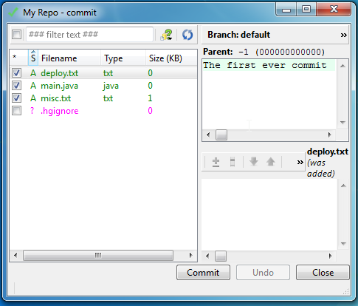
Check in changes to the repository
Parent of the revision. Since it is the first commit, it will be -1
“A” status means it has been added
2. Type a useful message that describes the commit
1. Select the files that are to be committed. Since this is the first commit, all the newly added files will be committed
3. Click “Add” to commit the changes

Slide 27
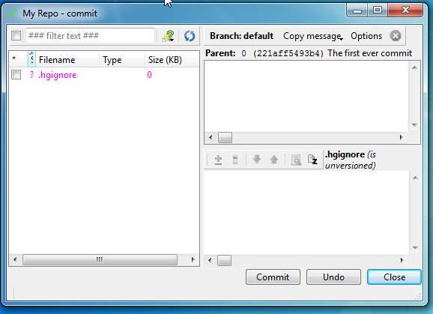
Check in changes to the repository
After the commit, the screen will remain open.
Notice that the next commit will have the first commit as its parent.
4. Close the window

Slide 28
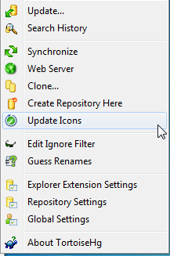
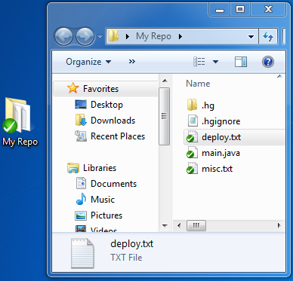
Check in changes to the repository
Select the “Update Icons” command to see the updated icon signs.
Notice the icon has changed for the files. The tick means that the file hasn’t been changed since the last stored commit in the repository.

Slide 29
View differences between revisions

Slide 30
What is a diff?
Diff is a file comparison utility that outputs the differences between two files
Typically used to show the changes between one version of a file and a former version of the same file.
Diff displays the changes made per line for text files.
The output is called a "diff", or a patch, since the output can be applied with the Unix program patch.
Revision Control Systems can display changes between files in the form of diff output or side-by-side comparisons using a ‘Visual Diff’ program.
Mercurial has its own Diff format which slightly differs from the unified GNU Diff format. (More Info: http://mercurial.selenic.com/wiki/GitExtendedDiffFormat)
Source: http://en.wikipedia.org/wiki/Diff

Slide 31
An example of diff output
Readme.txt (Original)
Mercurial Diff Output
Original line in document
Going to be deleted
@@ -1,2 +1,2 @@
Original line in document
-Going to be deleted
\ No newline at end of file
+New second line
\ No newline at end of file
Readme.txt (Modified)
Original line in document
New second line
How to read diff: http://www.markusbe.com/2009/12/how-to-read-a-patch-or-diff-and-understand-its-structure-to-apply-it-manually/

Slide 32
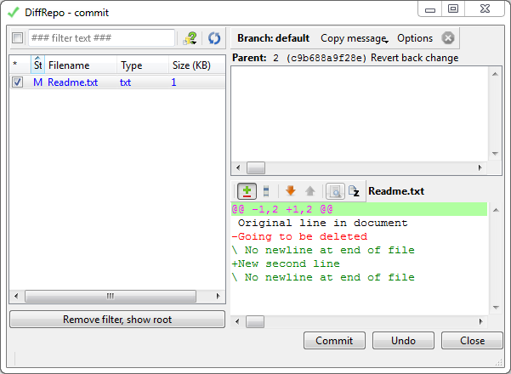
An example of diff output
You can see the diff output when you commit changes.
Diff output for readme.txt

Slide 33
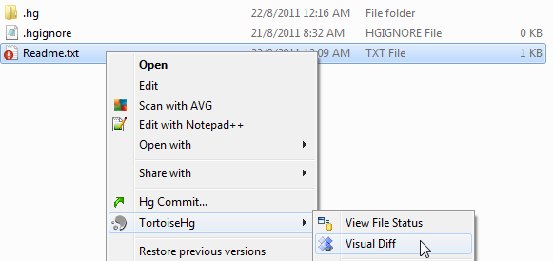
Side-by-side diff comparison
Changes in files which are yet to be committed can be viewed side-by-side between the latest committed version and the new uncommitted version.
Right-click on the changed file and then select the ‘Visual Diff’ command.

Slide 34
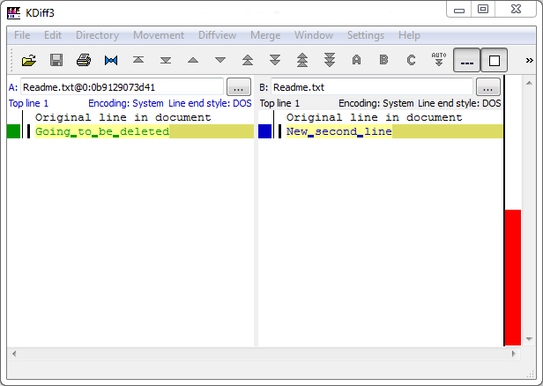
Side-by-side diff comparison
Kdiff3 is used by TortoiseHg to resolve conflicts and to visualize diffs between files. It makes it easy to resolve conflicts and analyze changes between files.

Slide 35
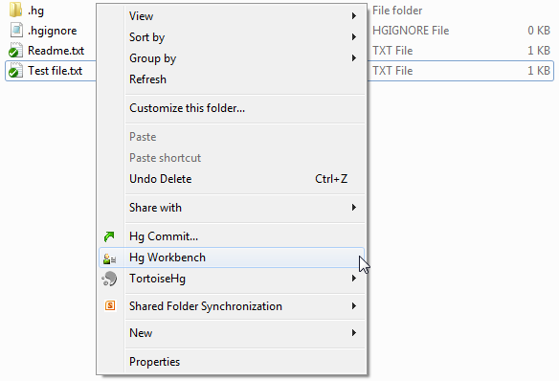
View differences between revisions
1. Right-click on the repository directory and select the “Hg Workbench” command

Slide 36
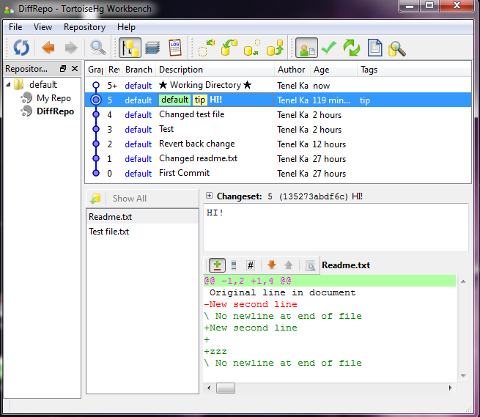
View differences between revisions
List of Revisions
Commit message for selected change set
List of files that were changed between Revision 5 and 4
Diff output between revision 5 and 4 for “Readme.txt”

Slide 37
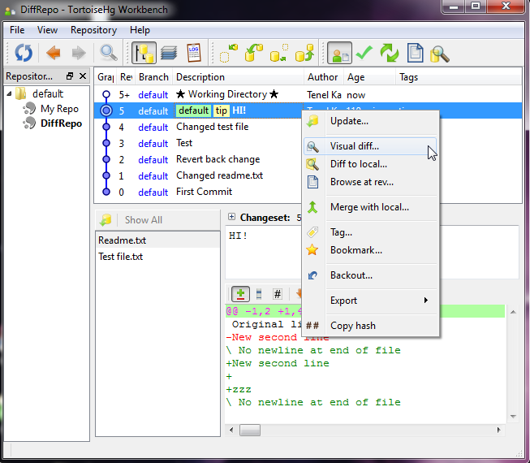
View differences between revisions
2. Right-click on a revision and select the “Visual diff…” command

Slide 38
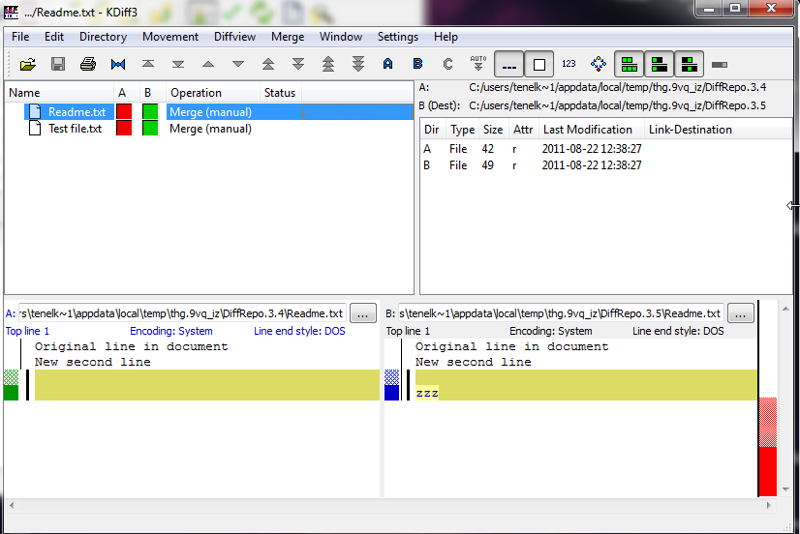
View differences between revisions
3. Double-click on the file to view the differences for that revision
“Readme.txt” in Revision 4
“Readme.txt” in Revision 5

Slide 39
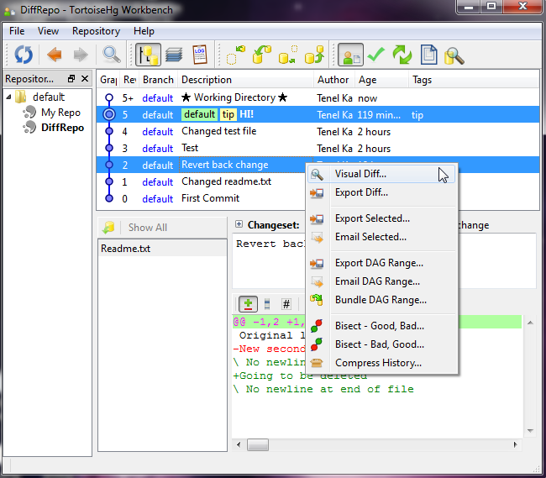
View differences between 2 particular revisions
Differences can also be viewed between two particular revisions
Select two revisions (using control-click) and right click on them and select the “Visual Diff …” command

Slide 40
Revert changes to files

Slide 41
Revert changes to files
Restore individual files or directories (in the working copy) to an earlier state, usually done if mistakes were made.

Slide 42
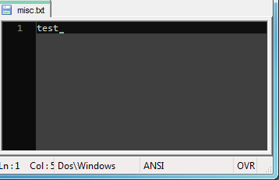
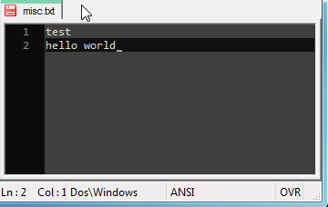
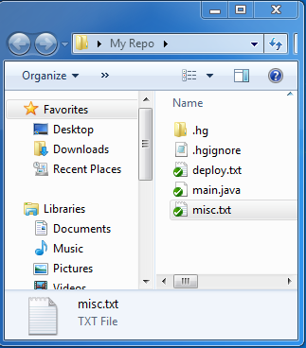
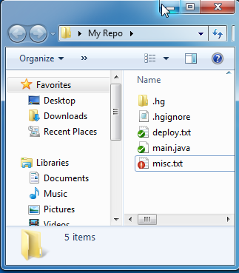
Revert changes to files
Let us make some changes to misc.txt
Notice the icon has changed for misc.txt. The exclamation mark indicates that the that the file has been changed.

Slide 43
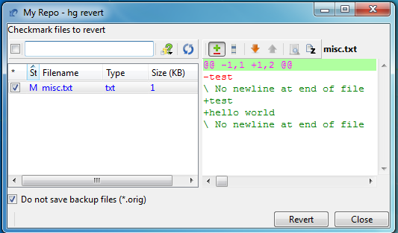
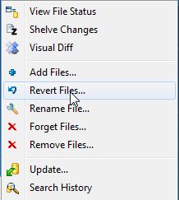
Revert changes to files
The changes were a mistake and we revert it.
“M” status means it is modified
Mercurial diff output
1. Right click the directory and select the “Revert Files…” command
2. Select the files to revert
2. Proceed to “Revert”

Slide 44
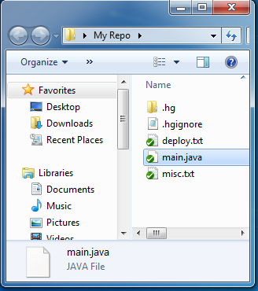
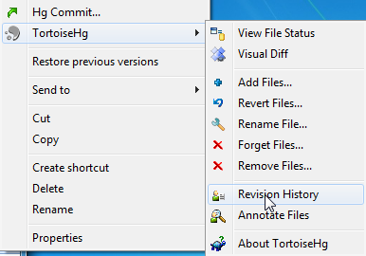
Revert changes to an earlier revision
We can also revert changes of files to an earlier revision.
2. Select misc.txt
3. Select “Revision History”
1. Make some additional changes to misc.txt and commit it

Slide 45
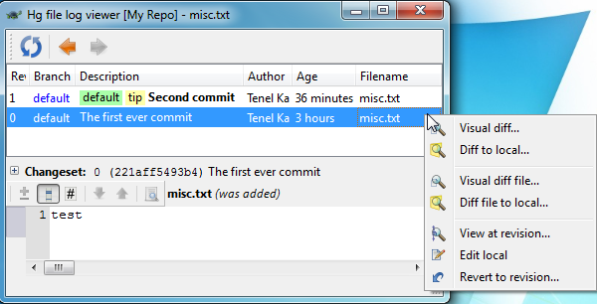
Revert changes to an earlier revision
Past commits
4. We are going to revert misc.txt back to revision 0. Right click revision 0 and select “Revert to revision…”

Slide 46
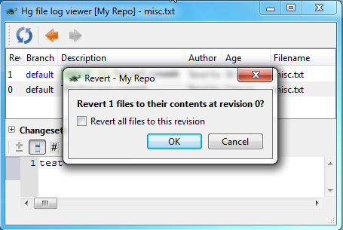
Revert changes to an earlier revision
You can also revert all files back to this revision
5. Revert the file

Slide 47
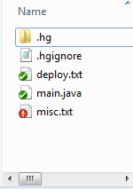
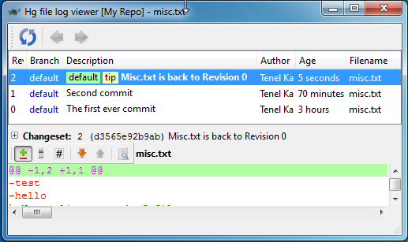
Revert changes to an earlier revision
We need to commit the revert to ensure that the changes are saved.
Notice that misc.txt is modified. This is because it is now back to Rev 0, but the latest commit in the repository is actually Rev 1.
6. Commit one more time to ensure that the revert is saved.

Slide 48
Label a revision for easy reference

Slide 49
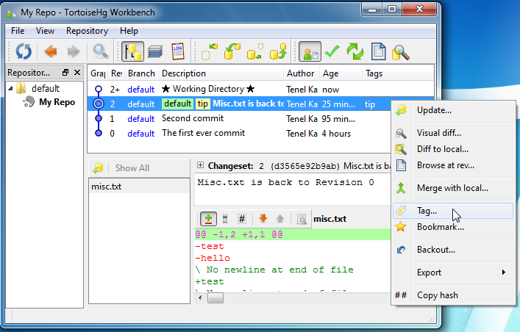

Label a revision for easy reference
In software development, it is good practice to label specific revisions as releases for commercial release to the public. In Mercurial, we can give specific revisions meaningful names such as Version 1.0 through tagging.
1. Right-click on the working copy and select “Hg Workbench”
2. Right-click Revision 2 and select “Tag…” to tag it

Slide 50
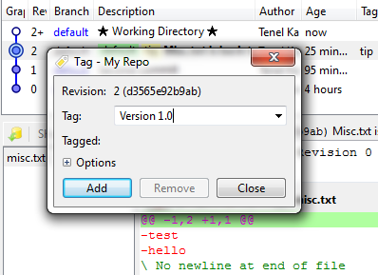
Label a revision for easy reference
3. Enter the tag name
4. Add the tag name

Slide 51
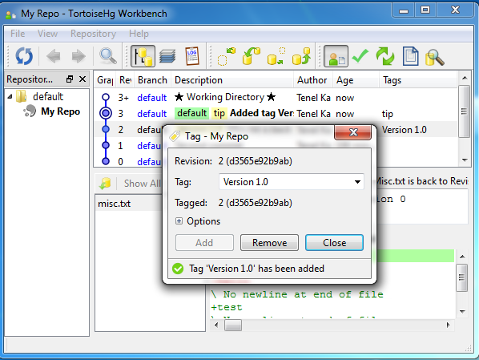
Label a revision for easy reference
Notice how a new revision is created. That’s right, tagging automatically introduces a new revision.
5. Close the window

Slide 52
Summary
Congratulations, you have learnt how to
Create a local repository
Add files to the repository
Check in changes to the repository
View differences between revisions
Revert changes to files
Label a revision for easy reference

Slide 53
Basic concepts of RCS (Individual use)
Concept | Definition
Repository (Repo) | The database where the files and historical data are stored, including the author of the changes and the summary of each change. Commonly called repo for short.
Working Copy | The local directory of your files.
Check in (Commit) | Uploads a changed file or a set of changed files to the repository. Commonly known as commit.
Revision | A revision is the set of changes whenever a check in is performed. Each revision is given a number.
Check out | Downloads a file or a set of files from the repository (for the first time).
Add | Tells the Version Control System to track a file, a set of files or a directory. These tracked files do not go into the repository until the next check in.
Update | Synchronize the files in your working copy with the latest files from the repository. This is normally performed after a check out.
Revert | Discards all changes in the working copy and use a specified revision from the repository.
Tag | Label a revision for easy reference.

